Slide 1
French revolution
France abolishes monarchy and becomes a republic
Presented by: group number 4
Shreya, Sakshi, almas, Amaan, taufeeque

Slide 2
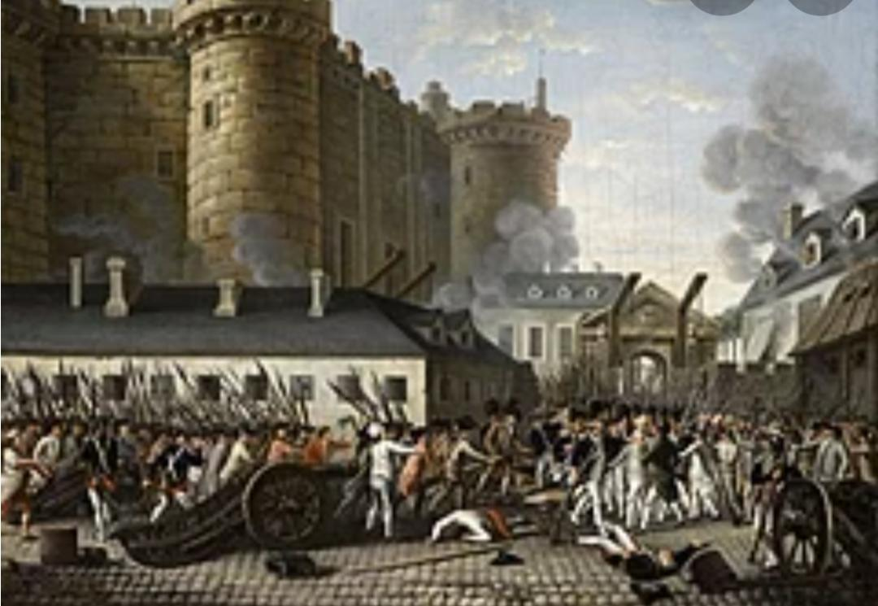
French Revolution

Slide 3
Topics to be covered:
France abolishes monarchy and becomes republic
The reign of terror
A directory rules France

Slide 4
In the earlier topics that how French societies formed during the eighteenth century and how it was divided into 3 Estates. The upper two sections were privileged By birth. The third state had to pay all the direct and indirect taxes proposed by State or estate.
Then we read how subsistence crisis hit France. We read many reasons such as political, social and Economic due to which revolution took place. We read how philosophers ignited the mind of the third state.
Then we had the Immediate cause due to which the revolutions outbreak took place.

Slide 5
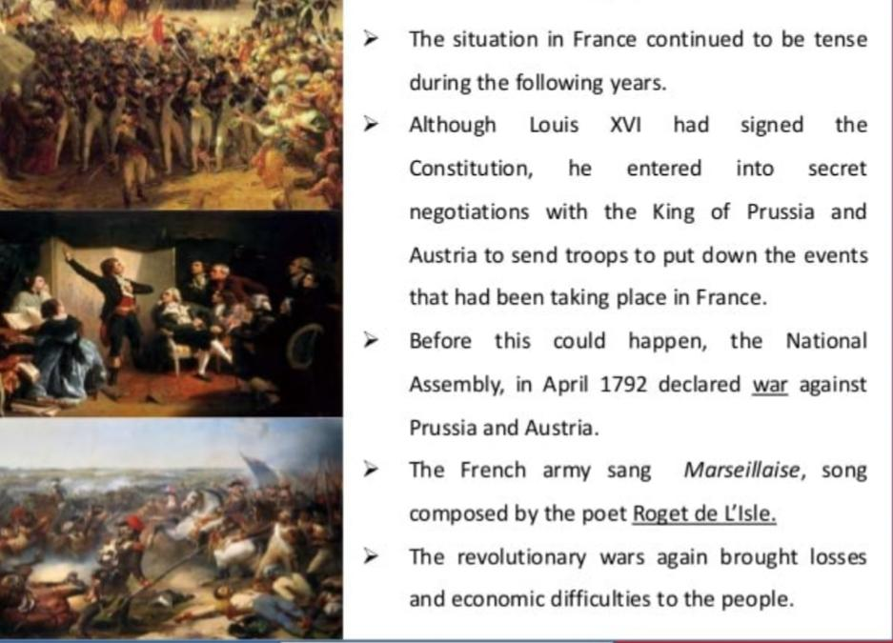

Slide 6
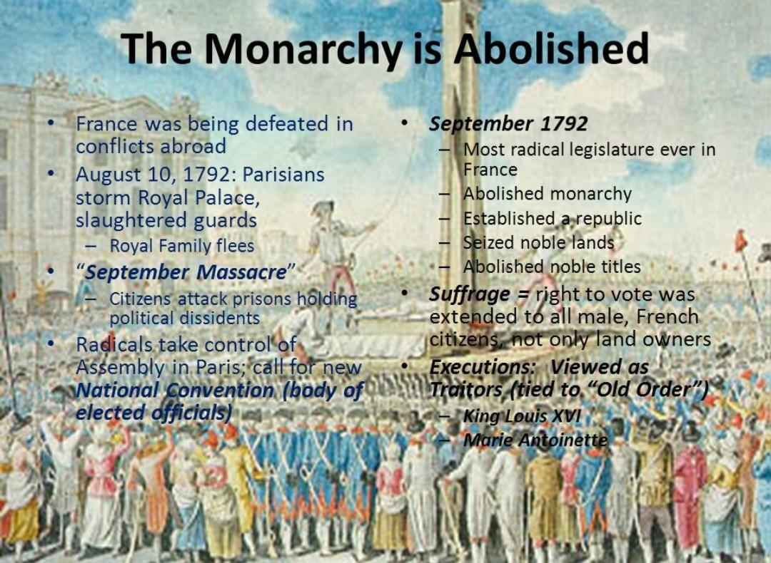

Slide 7
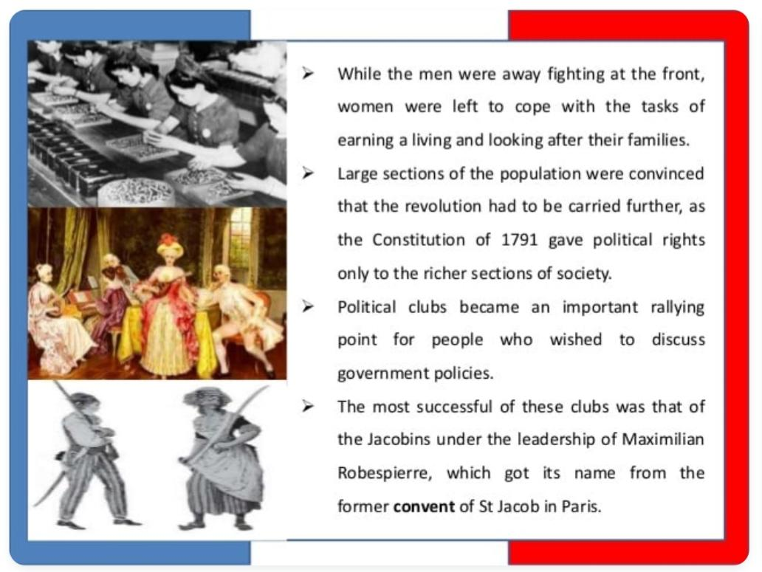

Slide 8
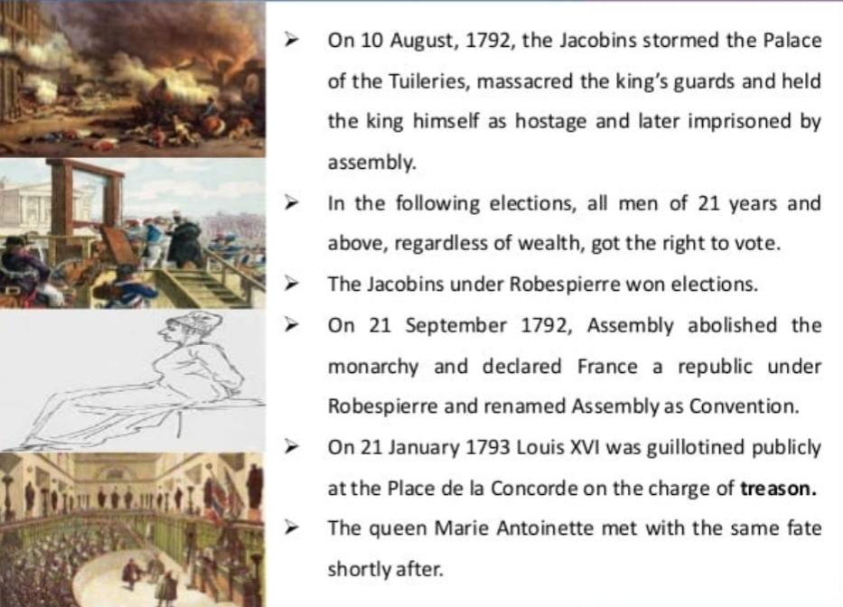

Slide 9
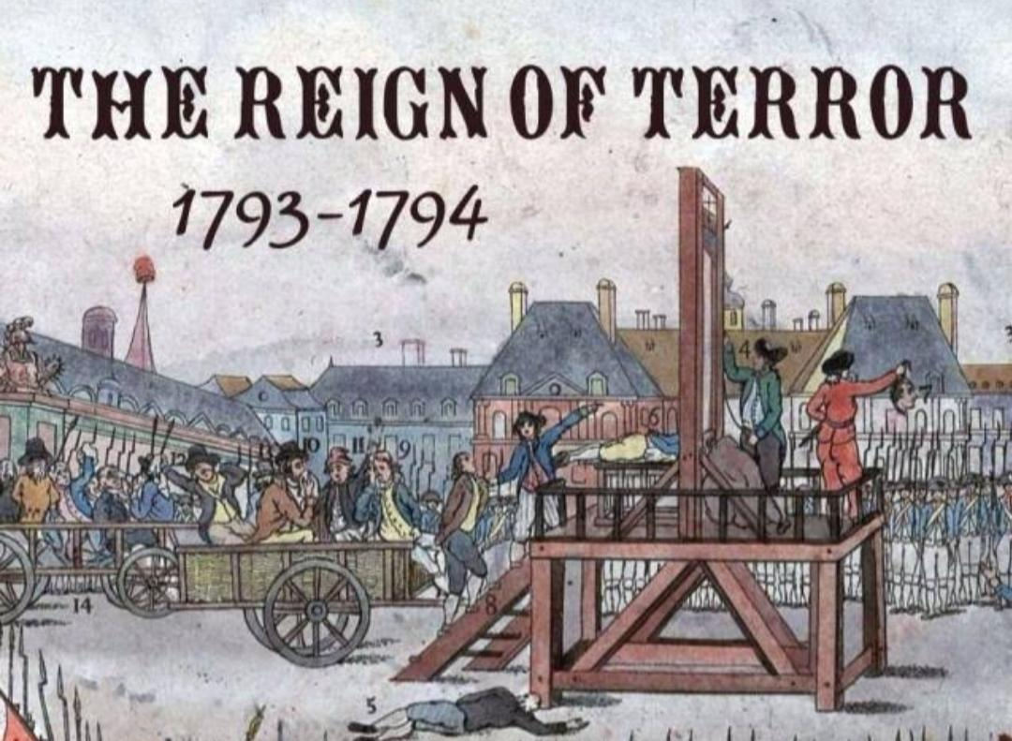

Slide 10
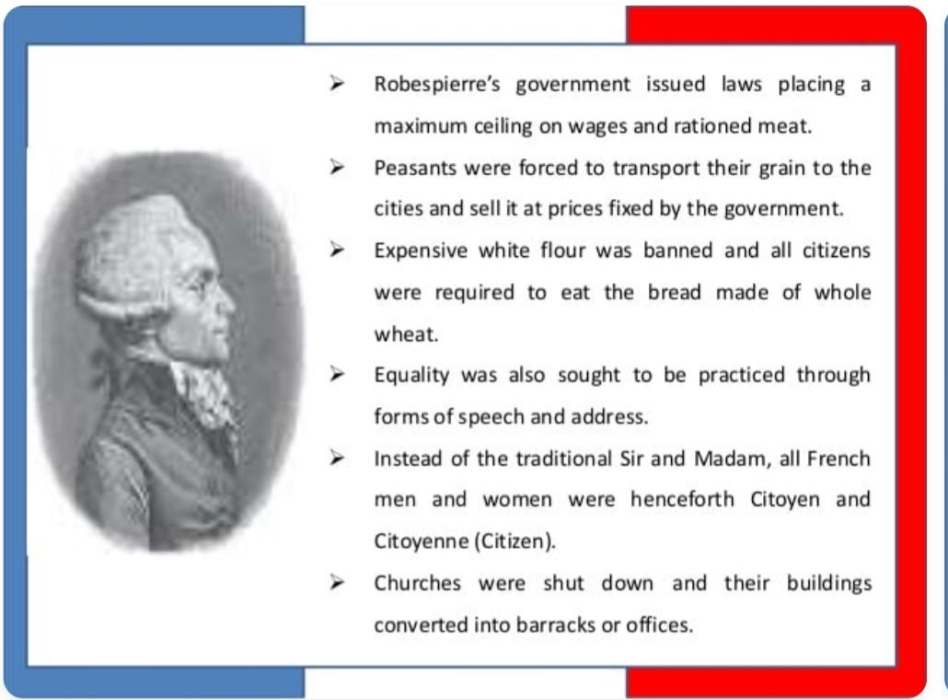

Slide 11


Slide 12
Rule of directory

Slide 13
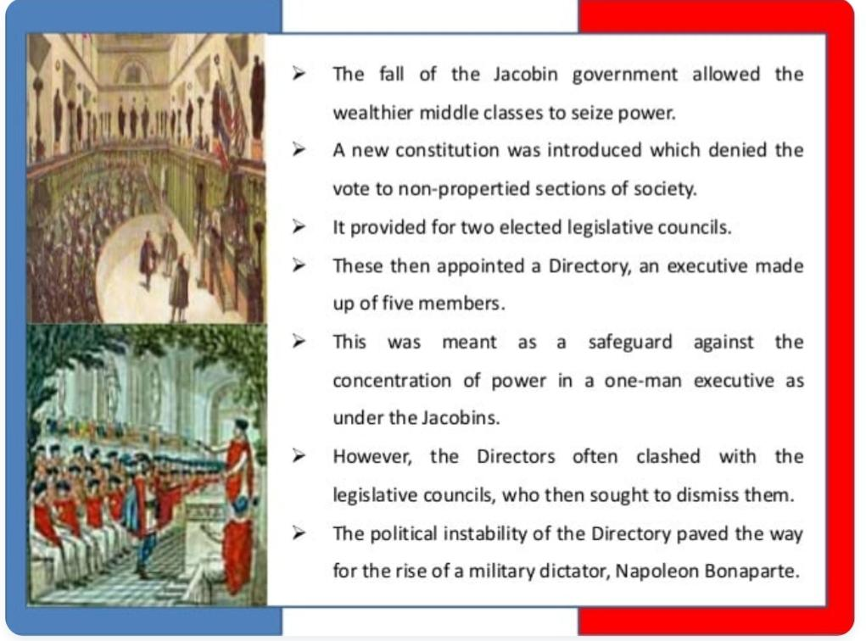

Slide 14


